Slide 1
Adventures in Poisson
Finnbar and Lukas
(code is available from github.com/finnbar/something-fishy)
Under the sea…. Under the sea…
Notes:
LUKAS
* We did the computational strand! * It went great!

Slide 2
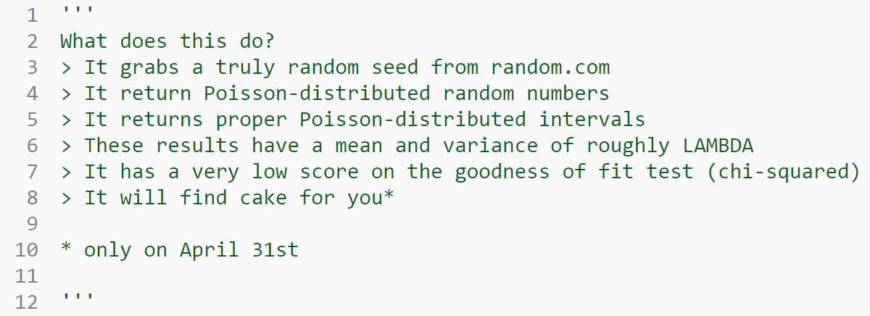
Notes:
Explain what the simulations were actually simulating!
What was the goal of the project?
LUKAS
* Here’s what we implemented!

Slide 3
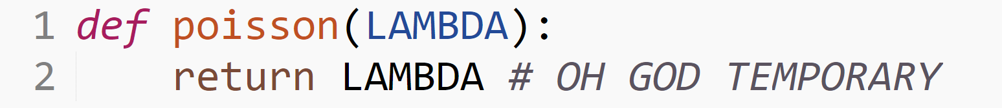
Attempt 1:
It didn’t work…
Notes:
FINNBAR
* Our first attempt didn’t work…

Slide 4
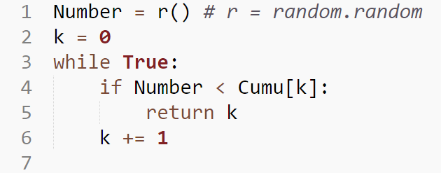
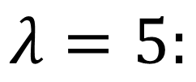
Attempt 2: Cumulative Probabilities
$$λ=5:$$
It’s like a simulation!
Notes:
FINNBAR
The code generates a list of cumulative probabilities, then a random number is generated.
The lowest value in the list for which the random number is less than it is selected.
So it’s like a simulation!

Slide 5
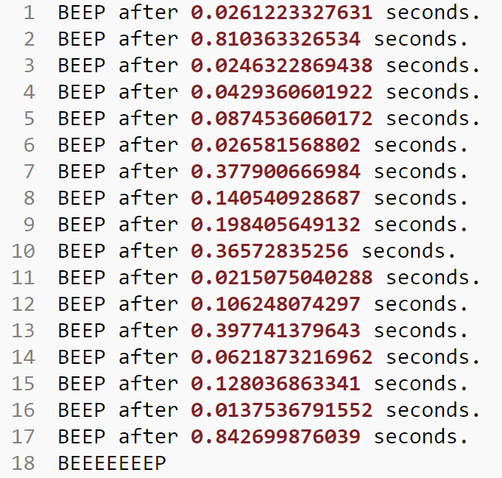
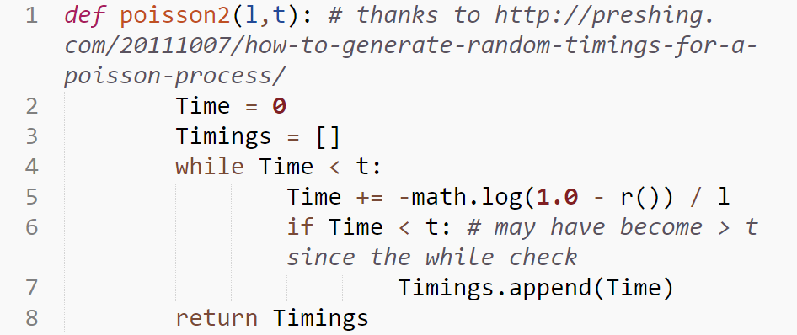
Attempt 3: Exponential Distributions
Poisson processes follow an exponential distribution, so there’ll be some logs involved.
r() will always return a value less than one, so it will never try to do log(0).
Notes:
FINNBAR
Poisson intervals follow an exponential distribution.
This line generates a new interval to follow!
Here’s a simulated Geiger counter!

Slide 6
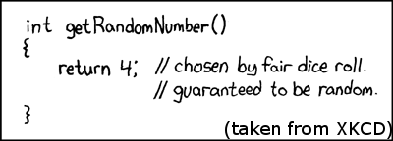
Random Numbers!
Notes:
LUKAS
* We were going to show you our first attempt, but XKCD beat us to it…

Slide 7
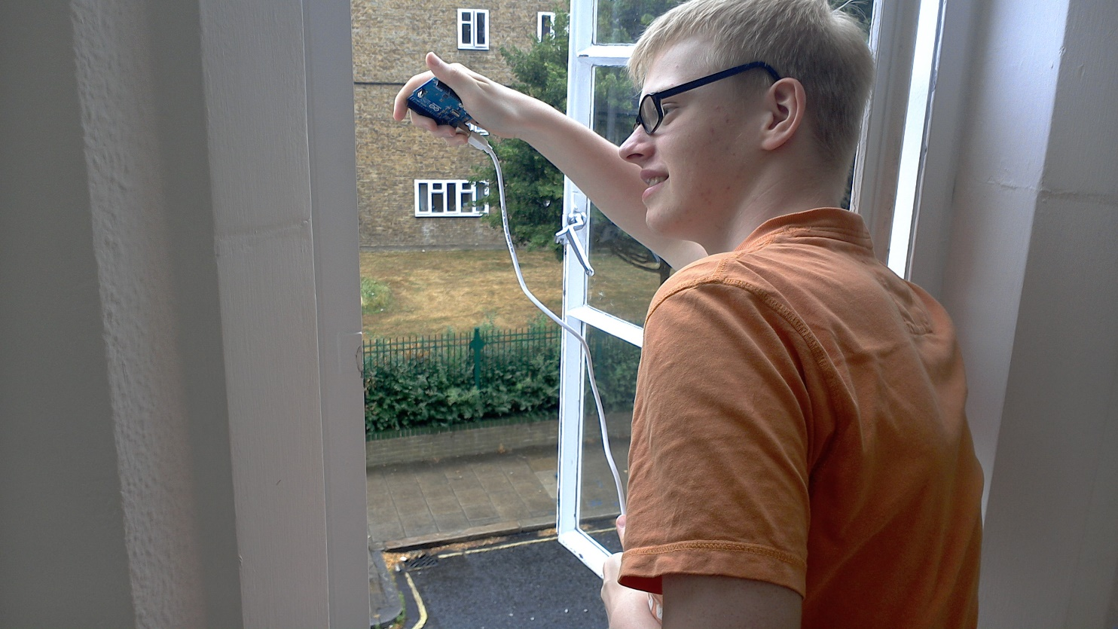
Random Numbers! (attempt 2)
We didn’t plug it in…
Notes:
LUKAS
* We tried to collect atmospheric data the hard way… but we forgot to plug it in.

Slide 8
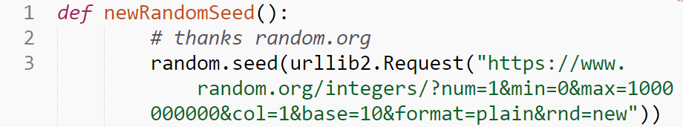
Random Numbers! (attempt 3)
urllib2.Request, or “go to this webpage please and return its contents thanks”
Notes:
LUKAS
We asked random.org for proper random numbers.
This makes the pseudorandom generators produce random numbers.
Computers use pseudorandom generators to generate random numbers (fun fact: these tend to use awkward bitshift operations, but that’s not really relevant), which means that they are technically predictable if you had a lot of time on your hands. These generators start off with a “seed”, which they modify to find random values. Most of the time this is enough, but where’s the fun in that? So, we asked random.org for our random seed (random.org provides random numbers from atmospheric data). Which is not as fun as standing on the roof collecting atmospheric data, but it is much quicker!

Slide 9
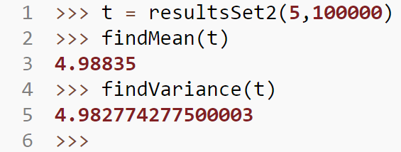


Mean and Variance
$$For X\sim Po\left(λ\right):$$
$$λ=\overline{X}=σ^{2}$$
(if you do enough tests)
Notes:
LUKAS
* For a Poisson distribution, the mean and variance should equal lambda, if you wait for long enough. Fortunately, they’re pretty close here!

Slide 10
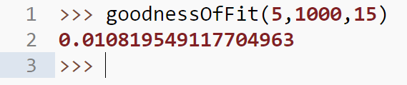
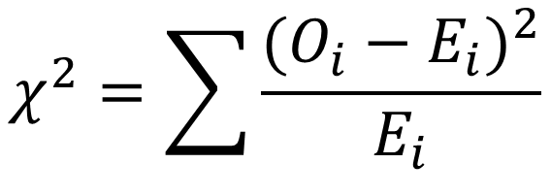
The Chi-Squared Test
$$χ^{2}=\sum{\frac{{(O_{i}−E_{i})}^{2}}{E_{i}}}$$
Notes:
FINNBAR * Test of how well it fits a set.
* Chi is pronounced Kai, I think.
* It’s not a bad fit, especially as low values are good!
* (the arguments are goodnessOfFit(LAMBDA, trials, largest i to check Oi for))

Slide 11
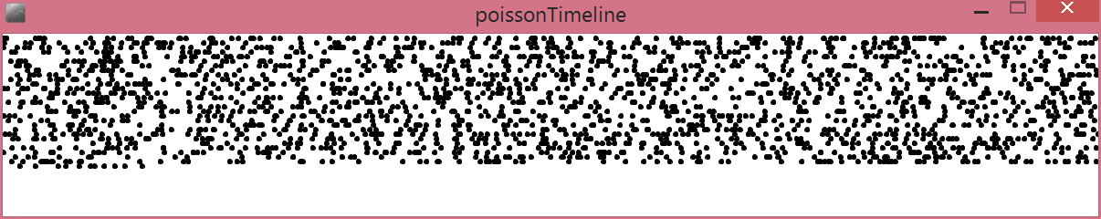
Pretty Pictures of Poisson!
These aren’t particularly useful, but they look nice!
Notes:
FINNBAR
* Poisson Timeline! This plots Poisson events on multiple lines, yay!

Slide 12
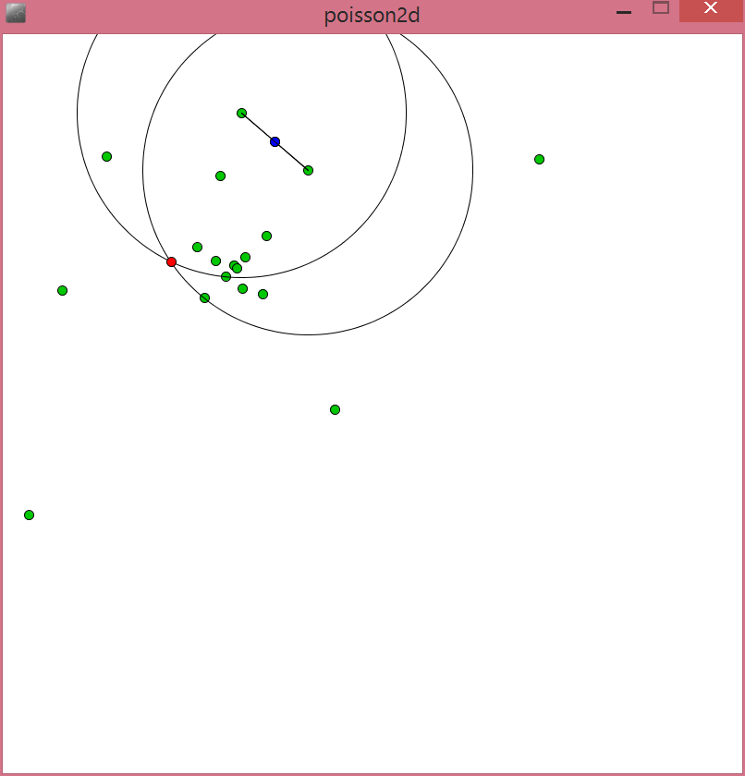
Notes:
FINNBAR
* Poisson2D – this draws two points, then draws new points which are a Poisson-distributed interval distance apart (only if these new points aren’t too close to any other points), and then selects two random points and does it again. And again! Now we’ll actually show you them and take questions. Thank you for listening!

